Slide 1

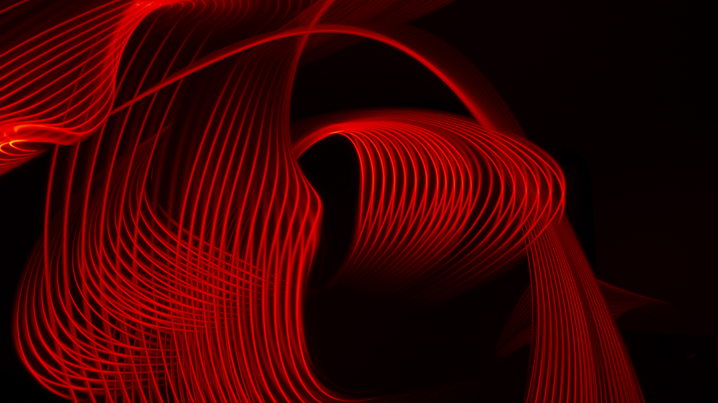
The Muscular System

Slide 2
From the Curriculum
Muscular system locomotion and balance is facilitated by the structure and actions of the skeletal muscles skeletal muscles work in groups around joints to bring about the desired action, while maintaining stability of the joint and providing strength to the action the structure of muscles allow for small movements at cellular level to combine to produce large, strong movements used in walking, balance and arm movements | 3 | structure of skeletal muscles and action of the skeletal muscles and how they facilitate locomotion and balance how skeletal muscles work in groups to bring about an action
 | 4 | how muscles maintain the stability of the joint how muscles provide strength to an action
 | 5 | how the structure of muscles allows for movements at a cellular level to combine to produce large, strong movements used in walking, balance and arm movements | Task One: Muscular and Skeletal Systems

Slide 3
Assessments
Task One: Muscular and Skeletal Systems

Slide 4
An introduction to muscles
Muscle cells are in the form of long, thin fibres that have the ability to contract.
The muscles that move bones and enable us to walk, and carryout a wide range of voluntary physical activities are the skeletal muscles (a type of muscle).
These muscles are under conscious control and attached to the bones of the skeleton.

Slide 5
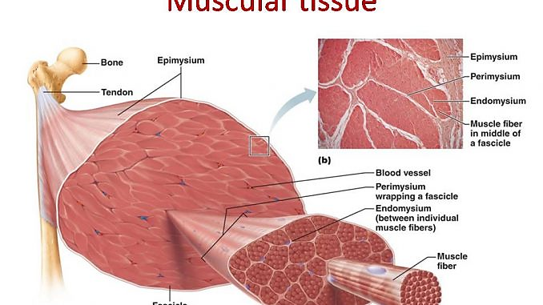

Slide 6
Types of muscle
Two other types
Many of the internal organs, such as the stomach and intestines, have muscles for movement. These are known as smooth muscles or, because they are not under conscious control, involuntary muscles.
A third type of muscle heart muscle. This is known as cardiac muscle’

Slide 7
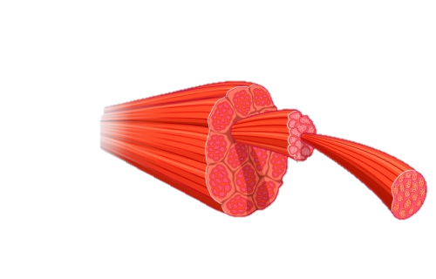
Structure of skeletal muscles
Muscle cells are held together in bundle.
Red meat is muscle and it is these bundles of muscle cells that give meat its ‘stringy’ appearance when cut lengthwise.
A sheath of connective tissue surrounds each bundle so that it can function as an individual unit.

Slide 8
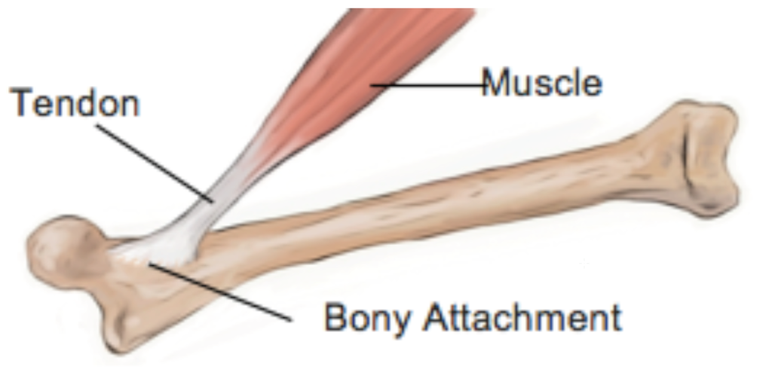
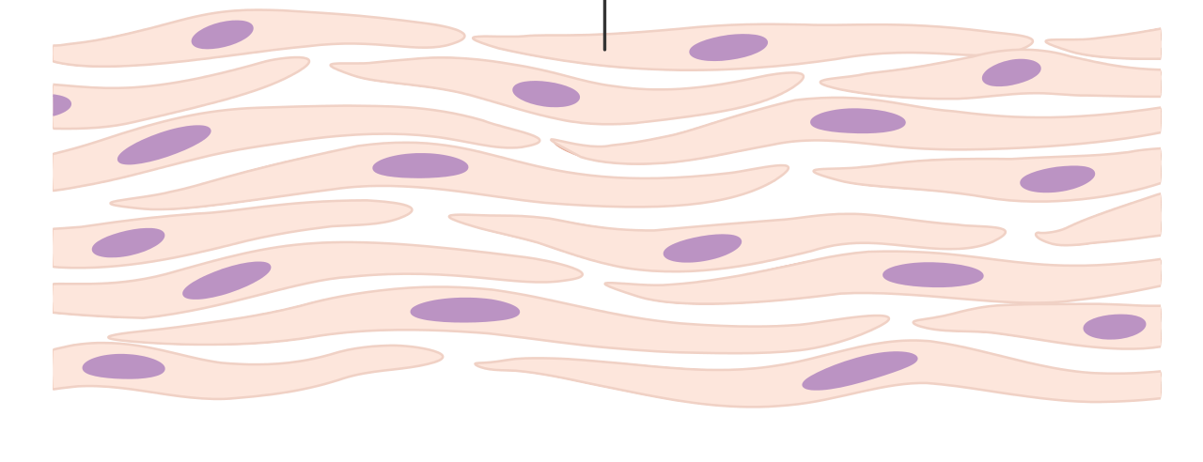
Continued
The connective tissue allows adjacent bundles to slide easily over one another as they contract.
The sheaths of connective tissue around each bundle join each other, and towards the end of the muscle they taper and blend to form the tendon.

Slide 9
Continued
The amount of connective tissue increases with advancing age, which is probably the reason why meat is less tender when it conies from an older animal.
Increased amounts of connective tissue are also thought to contribute to the decrease in muscular strength that gradually occurs as a person gets older.

Slide 10
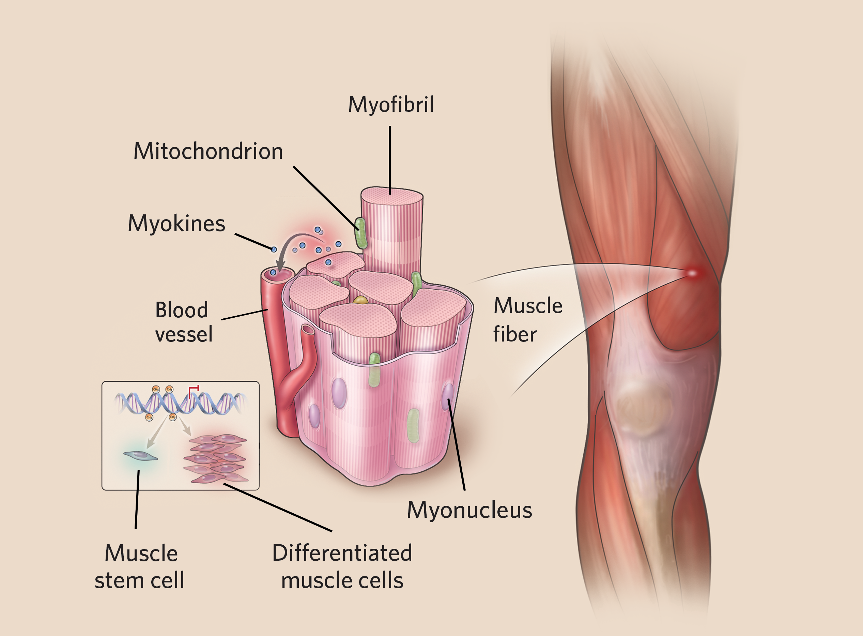

Slide 11
Continued
Each muscle cell is an elongated cylinder with many nuclei. Around the cell is a thin, transparent plasma membrane, the sarcolemma, containing cytoplasm, called the sarcoplasm.
These cylindrical cells are the muscle fibres. They are between 10 and 100 micrometres in diameter and vary in length from a few millimetres to several centimetres.
Within the sarcoplasm of each fibre there are thread-like myofibrils, lying parallel to each other and running the length of the fibre. There may be from hundreds to several thousands of these myofibrils in each fibre.

Slide 12
Structure of myofibrils
The myofibrils are composed of many smaller myofilaments, made of protein, which are the actual units involved in contraction of the muscle.
There are two types of myofilaments:
thick myofilaments, composed mainly of the protein myosin; and
thin myofilaments, composed mainly of the protein actin.

Slide 13
Continued
When a muscle fibre is supplied with sufficient energy and is activated by a nerve impulse, these thick and thin protein filaments slide past each other in a manner that shortens the myofibril.
Arrangement of thick and thin filaments within a myofibril gives a banded effect to the muscle. It is these bands that give skeletal and cardiac muscle fibres their striated appearance when viewed under a microscope.

Slide 14
Continued
Myofibrils can be divided into units called sarcomeres.
The striated appearance of skeletal muscle is due to variations in the actin and myosin content in different parts of the sarcomere.

Slide 15
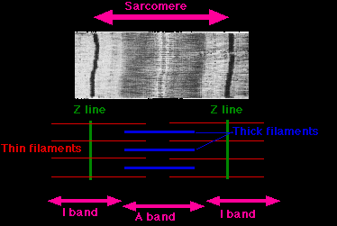

Slide 16
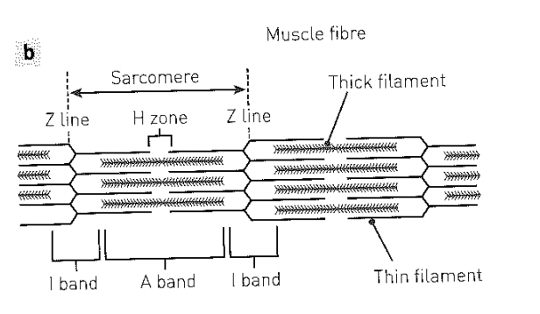
The structure of sarcomeres: the I band consists only of thin filaments and is crossed by the Z line; the A band is made up of thick filaments that overlap at either end with thin filaments. A single sarcomere extends from one Z line to the next.

Slide 17
SUMMARY
Skeletal muscle is made up of bundles of muscle fibres each of which contains myofibrils which contain myofilaments of two types: actin and myosin.

Slide 18
Sliding filament model
Muscles are the only tissues that have the ability to contract. To explain how muscle contraction occurs, a sliding filament model has been proposed.
When muscles contract, the sarcomeres shorten. The model suggests that this occurs because the actin and myosin filaments slide over one another.

Slide 19
Continued
As the thin actin filaments slide over the thick myosin filaments, the Z lines are drawn closer together and the sarcomere is shortened.
This results in a shortening of the muscle fibres and hence a shortening of the whole muscle (the myofilaments are the same length in the contracted position as they were before contraction). The fibril has shortened because the myofilaments overlap more.

Slide 20
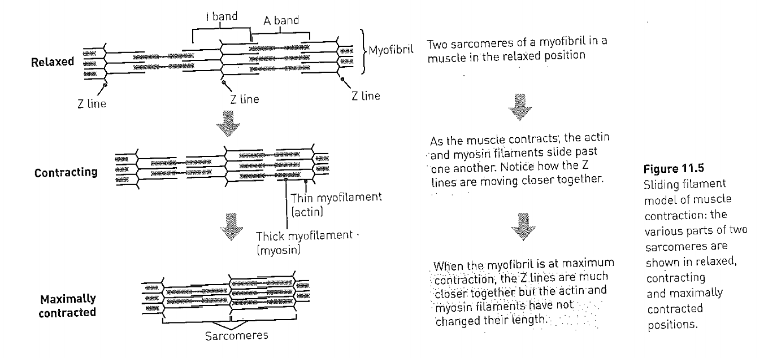

Slide 21
Continued.
When the muscle relaxes, the actin and myosin filaments can be pulled past one another in the opposite direction and the muscle fibre returns to its original, uncontracted state.
At any given time, some muscle fibres can be contracted while others are relaxed.

Slide 22
Continued.
Energy is required for shortening of the muscle fibres.
The energy comes from the breakdown of adenosine triphosphate (ATP) in the muscle cells.
Energy is released when breaks down to adenosine diphosphate (ADP) and a phosphate group.
When energy is again available from cellular respiration, ATP is re-formed.
ATP is the molecule that transfers energy from cellular respiration to processes such as muscle contraction.

Slide 23
Skeletal muscles working together
Muscles are attached to the bones of the skeleton by fibrous, inelastic connective tissue called tendons.
They are attached to the bones in such a way that they bridge the joints, so when contraction occurs the bones move. Muscles can only contract.

Slide 24
Continued
They can pull bones together but they cannot push them apart.
If muscles contract, pulling a bone in one direction, another set of muscles must contract to pull the bone in the opposite direction.
Thus, the muscles that move the parts of the skeleton are always grouped in pairs.

Slide 25
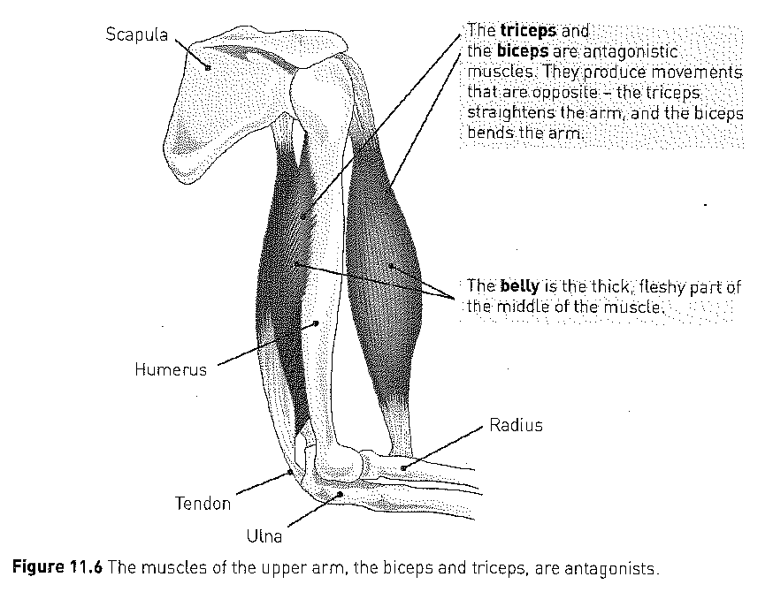
DRAW THIS DIAGRAM

Slide 26
Continued.
Antagonists aka opposite actions.
Coordination of the paired muscles provides body movement, with one of the pair producing movement of bones in one direction and the other producing movement in the opposite direction.
E.g. muscles of the upper arms

Slide 27
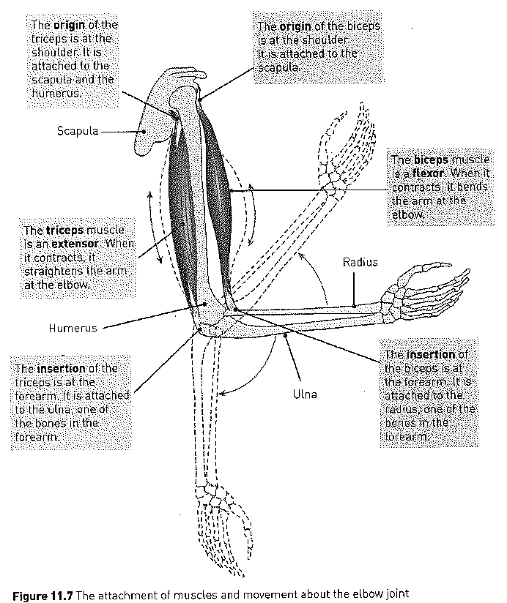

Slide 28
SCENARIO EXAMPLE
YOU NEED TO WRITE THE WHOLE SCENARIO- EST
The muscles of the upper arm are good examples of antagonists.
One end of the muscle on the front part of the upper arm, the biceps, is fixed to the scapula
The other end of the biceps muscle is attached to the radius.

Slide 29
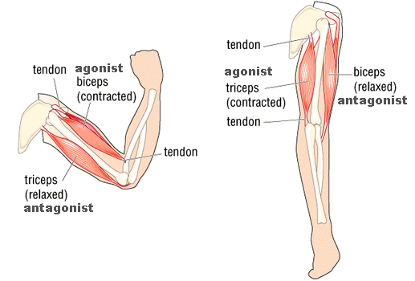

Slide 30
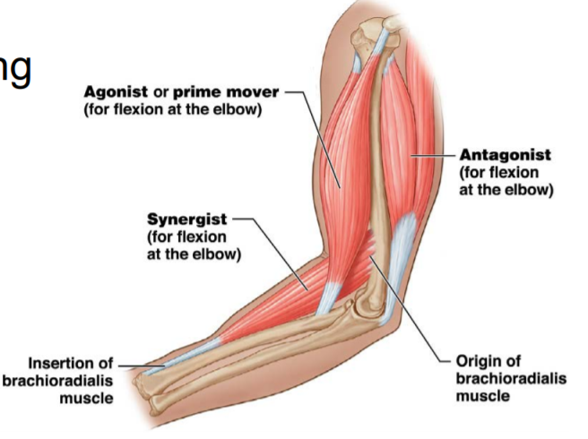

Slide 31
Scenario continued.
The muscle at the back of the upper arm, the triceps, is fixed to the scapula and to the humerus at one end, and to the ulna at the other.
To move the forearm about the elbow joint, these two muscles must cooperate.
When the biceps contracts to bend the arm, the triceps must relax; the opposite occurs when the arm is straightened

Slide 32
Scenario continued
When the biceps muscle contracts, the shoulder end remains stationary but the other end moves and bends the forearm.
The end of the muscle fixed to the stationary bone is called the origin.
The attachment of the other end of the muscle, to the movable bone, is the insertion.
The fleshy portion of the muscle between the tendons of the origin and the insertion is called the belly. A muscle that causes a desired action is called the agonist, or prime mover.

Slide 33
Scenario continued.
As mentioned, mentioned, while the biceps is contracting, the triceps is relaxing.
In this situation the biceps is the agonist, because it moves the forearm; the triceps is the antagonist, because it has an effect that is opposite to that of the agonist- that is, it yields to the movement of the agonist.
However, when the triceps is contracting to straighten the forearm, the biceps is relaxing and their roles are reversed.
Now the triceps is the agonist and the biceps the antagonist.

Slide 34
Synergists
In addition to agonists and antagonists, most joint movements involve muscles that act as synergists. Synergists are muscles that help the prime mover (largest agonist).
They may produce the same movement as the prime mover or they may steady a joint during a particular movement, so that unwanted movement is prevented and the prime mover (agonist) can function more efficiently

Slide 35
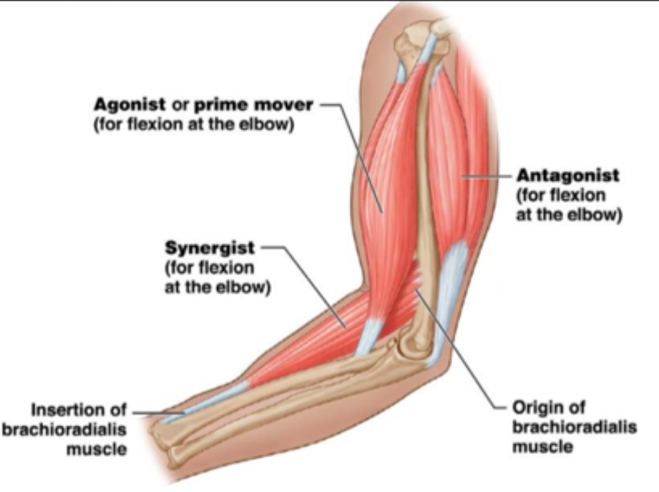
Synergists continued.
Example
The wrist would flex every time the fist was clenched if it were not for the synergistic muscles immobilising the wrist.

Slide 36
Synergists continued.
When a synergist immobilises a joint (e.g. like the wrist) it is called a fixator.
A fixator is a synergist muscle that assists by preventing movement at another joint.
A muscle may assume different roles depending on the body movement occurring. The same muscle may at different times be an agonist, an antagonist or a synergist.

Slide 37
Muscle tone
Muscle tone is maintaining partial contraction of skeletal muscles.
At any one time, some muscle fibres are contracted while others relax.
E.g. the head is held up by the partial contraction of the neck muscles. When a person falls asleep sitting up, their head droops forwards. This is due to the loss of tone in the neck muscles.

Slide 38
Review Questions
1) What are the characteristics of muscles?
2) Using diagrams to illustrate your answer, describe:
The overall structure of a muscle
The microscopic structure of muscle tissue
3) Describe the sliding filament model and how muscle contraction occurs.

Slide 39
Review Questions
4) Explain how muscles produce movement about a joint.
5) What is the difference between agonists and antagonists?
6) What sort of muscle is the:
The biceps
The triceps
7) Describe the role of synergists.

